Slide 1
Support Vector machines
A Support Vector Machine (SVM) is a powerful and versatile Machine Learning model, capable of performing linear or nonlinear classification, regression, and even outlier detection.
SVMs are particularly well suited for classification of complex small- or medium-sized datasets.
It tries to find the best boundary known as hyperplane that separates different classes in the data.
It is useful when you want to do binary classification like spam vs. not spam or cat vs. dog.
The main goal of SVM is to maximize the margin between the two classes.
The larger the margin the better the model performs on new and unseen data.

Slide 2
Support Vector machines
Linear SVM Classification - linearly separable
Large margin classification
SVM classifier that fits s straight line or hyperplane (decision boundary) between the classes.
This line not only separates the two classes but also stays as far away from the closest training instances (support vectors)as possible.
Hard Margin Classification
If we strictly impose that all instances must be off the street and on the right side
Soft Margin Classification
SVM classifier that find a good balance between keeping the street as large as possible and limiting the margin violations
Nonlinear SVM Classification – non linearly separable
Classify data when it cannot be separated into two classes by a straight line using kernel functions

Slide 3
Types of Support Vector Machine
Based on the nature of the decision boundary, Support Vector Machines (SVM) can be divided into two main parts:
Linear SVM: Linear SVMs use a linear decision boundary to separate the data points of different classes. When the data can be precisely linearly separated, linear SVMs are very suitable. This means that a single straight line (in 2D) or a hyperplane (in higher dimensions) can entirely divide the data points into their respective classes. A hyperplane that maximizes the margin between the classes is the decision boundary.
Non-Linear SVM: Non-Linear SVM can be used to classify data when it cannot be separated into two classes by a straight line (in the case of 2D). By using kernel functions, nonlinear SVMs can handle nonlinearly separable data. The original input data is transformed by these kernel functions into a higher-dimensional feature space where the data points can be linearly separated. A linear SVM is used to locate a nonlinear decision boundary in this modified space.

Slide 4
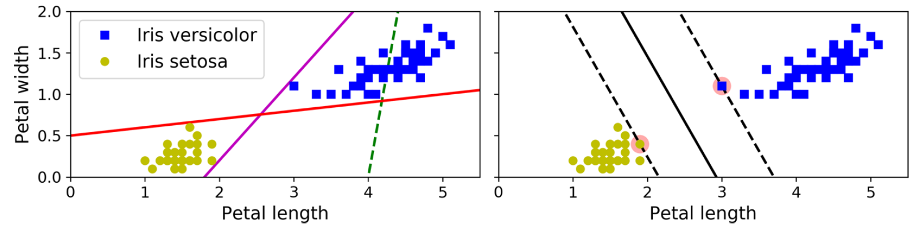
Linear SVM Classification

Slide 5
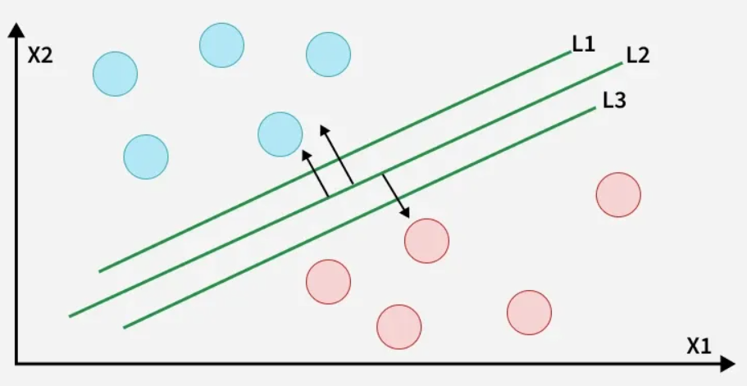
How does Support Vector Machine Algorithm Work?

Slide 6
How does Support Vector Machine Algorithm Work?
The key idea behind the SVM algorithm is to find the hyperplane that best separates two classes by maximizing the margin between them.
This margin is the distance from the hyperplane to the nearest data points (support vectors) on each side.
The best hyperplane also known as the "hard margin" is the one that maximizes the distance between the hyperplane and the nearest data points from both classes.
This ensures a clear separation between the classes. So, from the above figure, we choose L2 as hard margin.

Slide 7
Hard Margin Classification
If we strictly impose that all instances must be off the street and on the right side, this is called hard margin classification.
There are two main issues with hard margin classification.
It only works if the data is linearly separable.
It is sensitive to outliers.

Slide 8
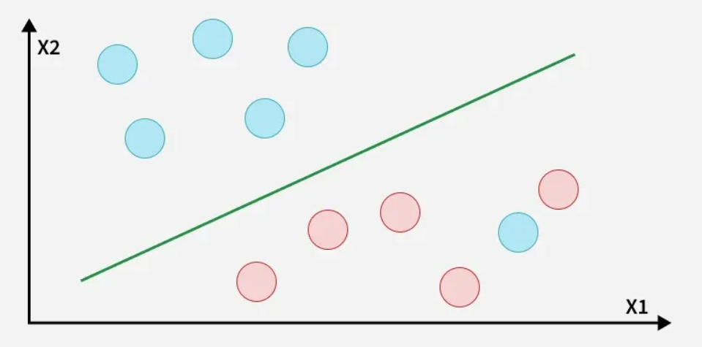
How does Support Vector Machine Algorithm Work?
The blue ball in the boundary of red ones is an outlier of blue balls. The SVM algorithm has the characteristics to ignore the outlier and finds the best hyperplane that maximizes the margin. SVM is robust to outliers.

Slide 9
Soft Margin Classification
To avoid these issues associated with hard margin classification, use a more flexible model.
The objective is to find a good balance between keeping the street as large as possible and limiting the margin violations (i.e., instances that end up in the middle of the street or even on the wrong side).
This is called soft margin classification.

Slide 10
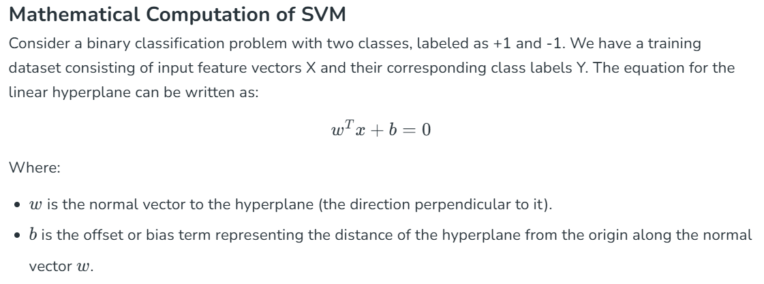

Slide 11
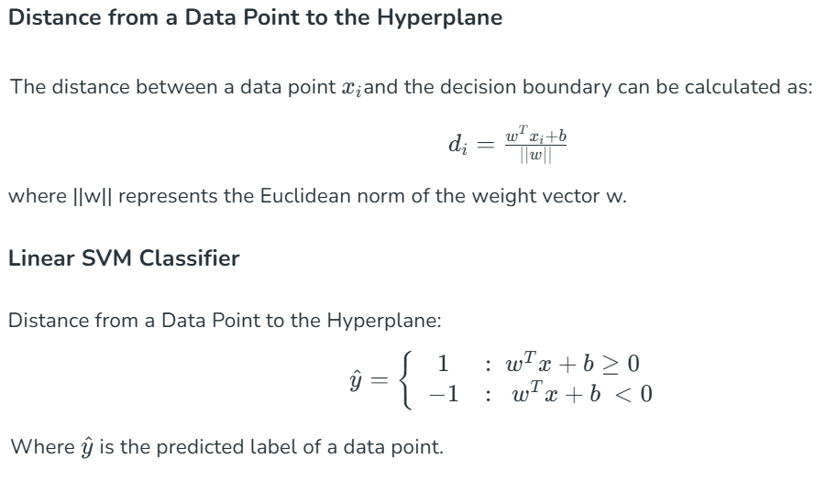
If the result is positive, the predicted class ŷ is the positive class (1), and otherwise it is the negative class (-1);

Slide 12
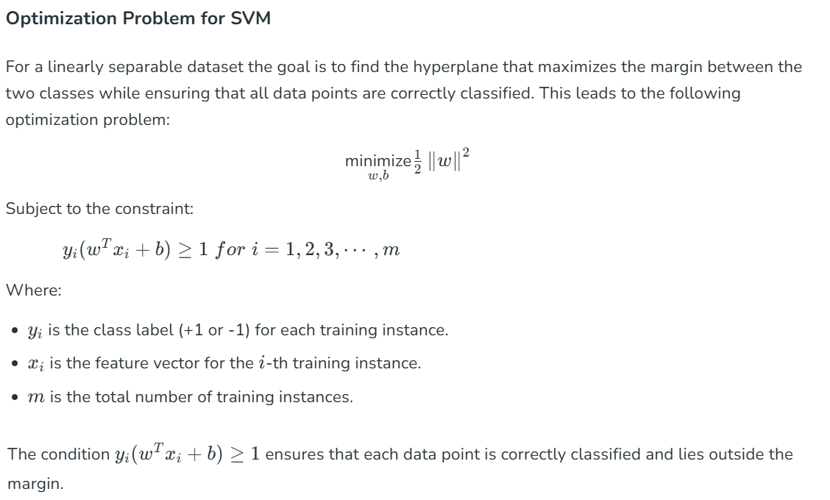
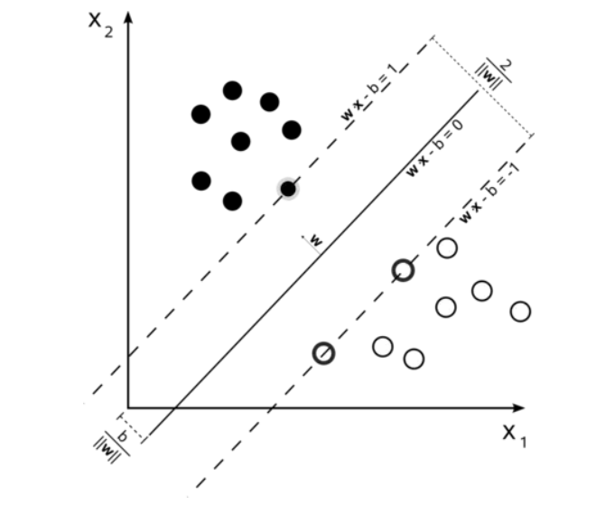
Hard Margin Linear SVM classifier objective

Slide 13
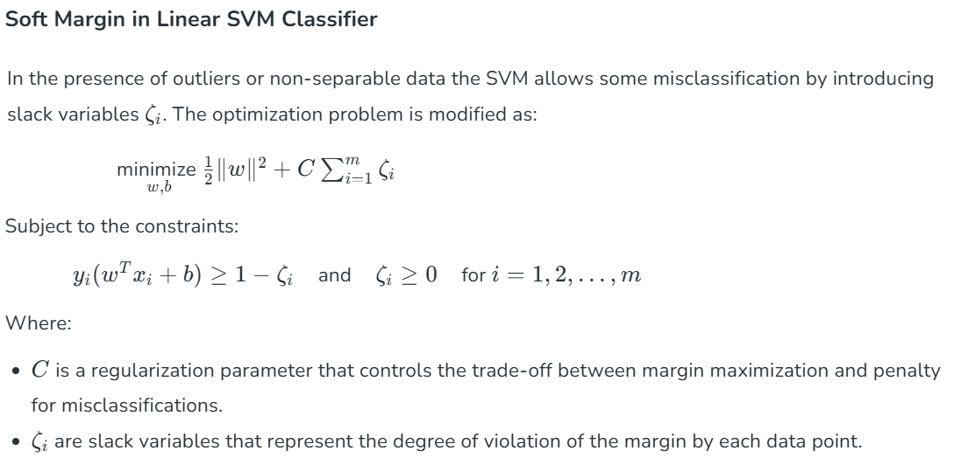

Slide 14
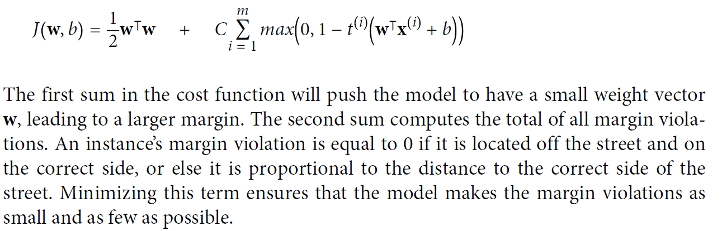
Linear SVM classifier cost function

Slide 15
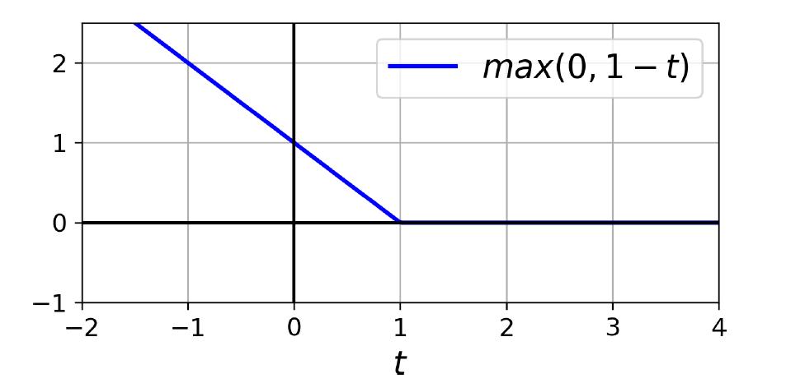
Hinge Loss
The function max(0, 1 – t) is called the hinge loss function (see the following image). It is equal to 0 when t ≥ 1. Its derivative (slope) is equal to –1 if t < 1 and 0 if t > 1. It is not differentiable at t = 1

Slide 16
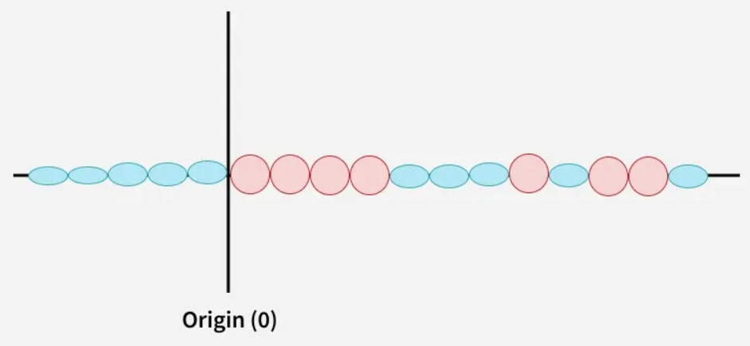
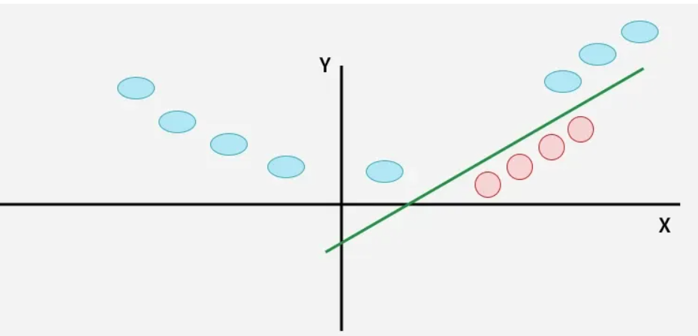
Nonlinear SVM Classification – non linearly separable
In this case the new variable y is created as a function of distance from the origin.

Slide 17
Nonlinear SVM Classification – non linearly separable
A kernel is a function that maps data points into a higher-dimensional space without explicitly computing the coordinates in that space.
This allows SVM to work efficiently with non-linear data by implicitly performing the mapping.
For example, consider data points that are not linearly separable.
By applying a kernel function SVM transforms the data points into a higher-dimensional space where they become linearly separable.
Linear Kernel: For linear separability.
Polynomial Kernel: Maps data into a polynomial space.
Radial Basis Function (RBF) Kernel: Transforms data into a space based on distances between data points.

Slide 18
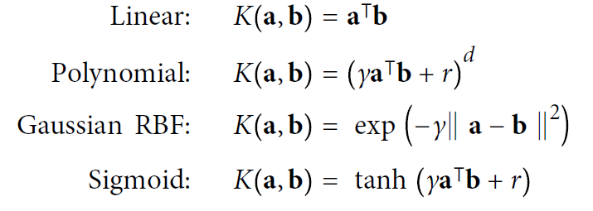
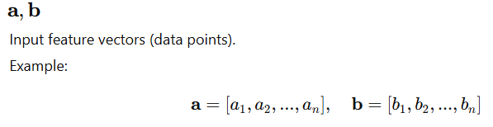
Nonlinear SVM Classification – non linearly separable

Slide 19
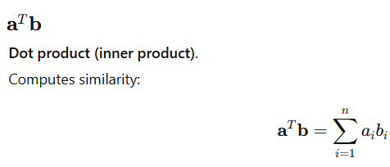
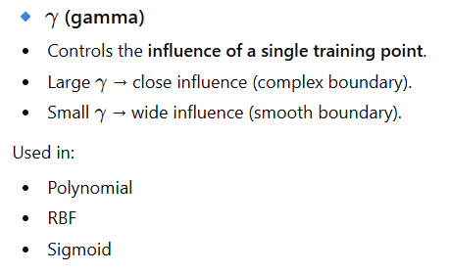
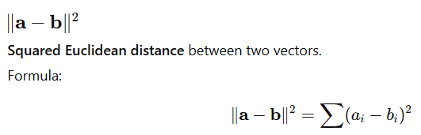
Nonlinear SVM Classification – non linearly separable

Slide 20
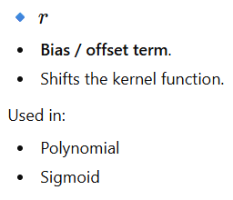
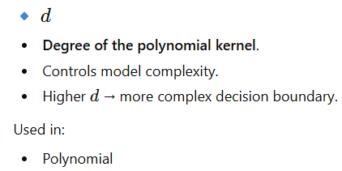
Nonlinear SVM Classification – non linearly separable

Slide 21
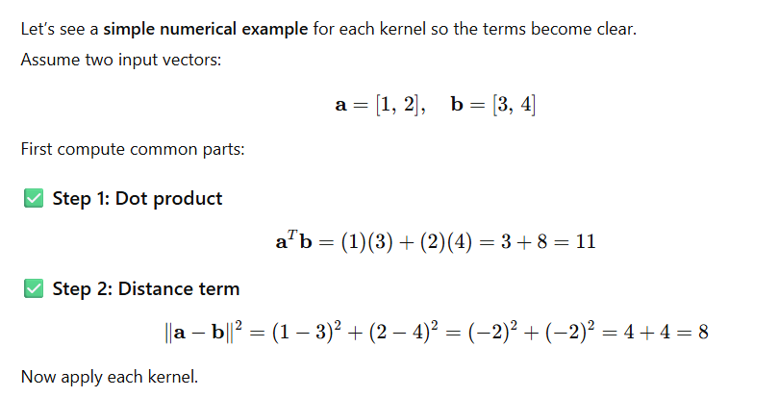
Nonlinear SVM Classification – non linearly separable

Slide 22
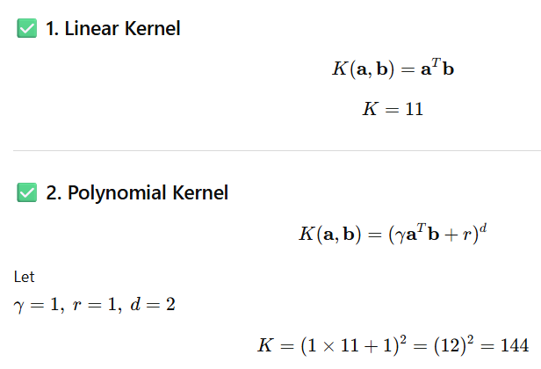
Nonlinear SVM Classification – non linearly separable

Slide 23
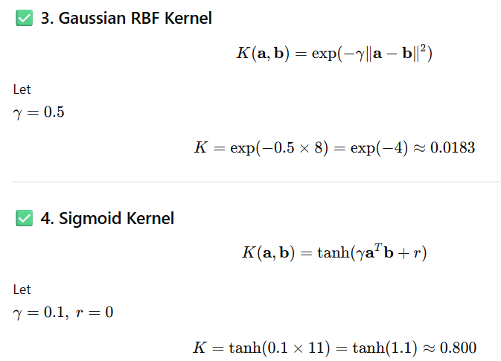
Nonlinear SVM Classification – non linearly separable

Slide 24
Key Concepts of Support Vector Machine
Hyperplane: A decision boundary separating different classes in feature space and is represented by the equation wx + b = 0 in linear classification.
Support Vectors: The closest data points to the hyperplane, crucial for determining the hyperplane and margin in SVM.
Margin: The distance between the hyperplane and the support vectors. SVM aims to maximize this margin for better classification performance.
Kernel: A function that maps data to a higher-dimensional space enabling SVM to handle non-linearly separable data.
Hard Margin: A maximum-margin hyperplane that perfectly separates the data without misclassifications.
Soft Margin: Allows some misclassifications by introducing slack variables, balancing margin maximization and misclassification penalties when data is not perfectly separable.3

Slide 25
Key Concepts of Support Vector Machine
C: A regularization term balancing margin maximization and misclassification penalties. A higher C value forces stricter penalty for misclassifications.
Hinge Loss: A loss function penalizing misclassified points or margin violations and is combined with regularization in SVM.
Dual Problem: Involves solving for Lagrange multipliers associated with support vectors, facilitating the kernel trick and efficient computation.

Slide 26
Advantages of Support Vector Machine (SVM)
High-Dimensional Performance: SVM excels in high-dimensional spaces, making it suitable for image classification and gene expression analysis.
Nonlinear Capability: Utilizing kernel functions like RBF and polynomial SVM effectively handles nonlinear relationships.
Outlier Resilience: The soft margin feature allows SVM to ignore outliers, enhancing robustness in spam detection and anomaly detection.
Binary and Multiclass Support: SVM is effective for both binary classification and multiclass classification suitable for applications in text classification.
Memory Efficiency: It focuses on support vectors making it memory efficient compared to other algorithms.

Slide 27
Disadvantages of Support Vector Machine (SVM)
Slow Training: SVM can be slow for large datasets, affecting performance in SVM in data mining tasks.
Parameter Tuning Difficulty: Selecting the right kernel and adjusting parameters like C requires careful tuning, impacting SVM algorithms.
Noise Sensitivity: SVM struggles with noisy datasets and overlapping classes, limiting effectiveness in real-world scenarios.
Limited Interpretability: The complexity of the hyperplane in higher dimensions makes SVM less interpretable than other models.
Feature Scaling Sensitivity: Proper feature scaling is essential, otherwise SVM models may perform poorly.

Slide 28
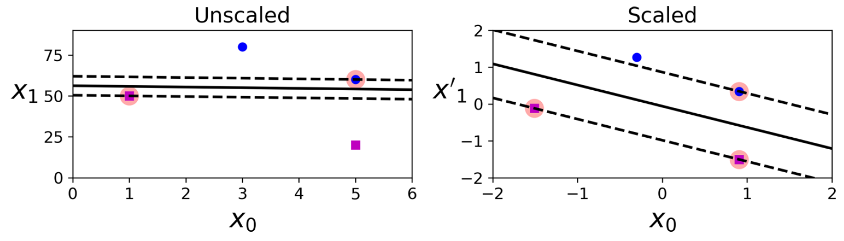
Feature Scaling Sensitivity
In the left plot, the vertical scale is much larger than the horizontal scale, so the widest possible street is close to horizontal.
After feature scaling (e.g., using Scikit-Learn’s StandardScaler), the decision boundary in the right plot looks much better.

Slide 29
Linear SVM Classification
Given the 2D dataset below with two linearly separable classes (blue = +1, red = -1), determine the equation of the optimal SVM hyperplane (L2) that maximizes the margin between classes.
POINT | X1 | X2 | CLASS
1 | 0.5 | 2.5 | 1
2 | 1.8 | 2.2 | 1
3 | 1.0 | 1.6 | 1
4 | 0.8 | 2.0 | 1
5 | 2.5 | 1.2 | -1
6 | 3.0 | 0.8 | -1
7 | 2.8 | 0.5 | -1
8 | 2.2 | 1.0 | -1

Slide 30
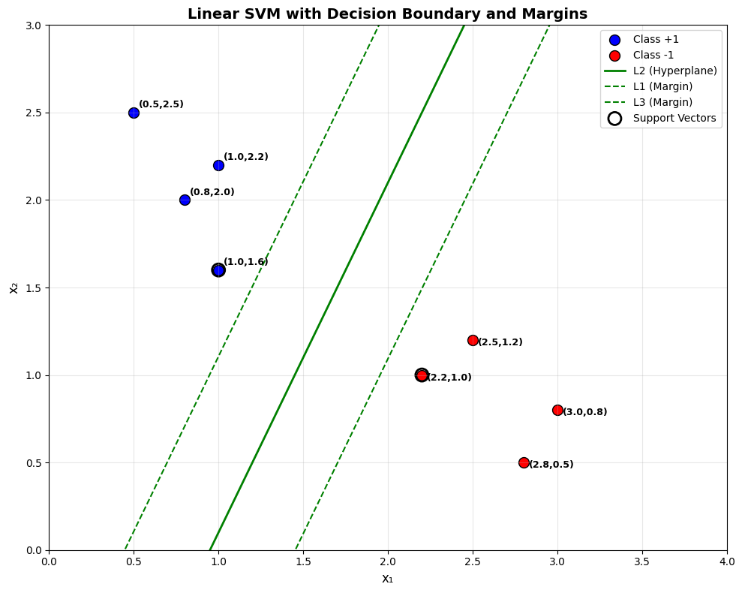

Slide 31


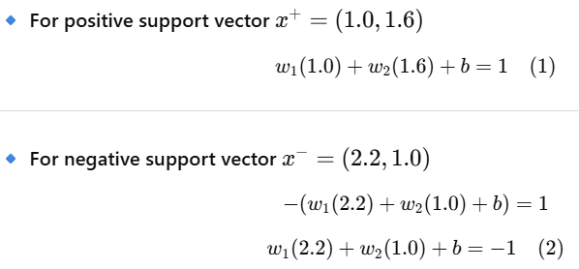

Linear SVM Classification
Visual Understanding
SVM Optimization Problem SVM solves: Subject to:
This is a quadratic optimization problem.
Identify Support Vectors (Closest Points)
Compute Direction of Hyperplane, find W
(2) –(1)

Slide 32
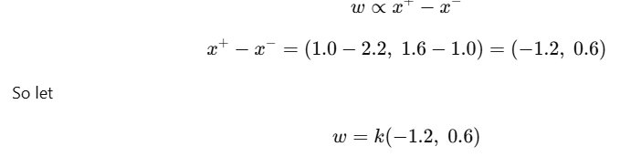
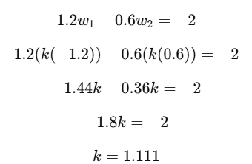
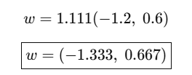

Linear SVM Classification
Find scale $k$

Slide 33
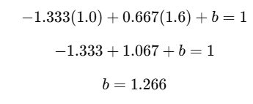
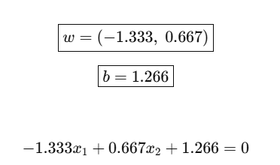

Linear SVM Classification
Find Bias $b$

Slide 34
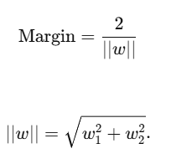
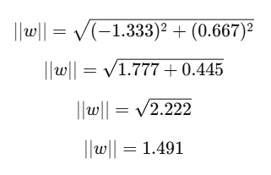
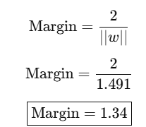

Linear SVM Classification
Find Margin

Slide 35
SVM Regression
Support Vector Regression (SVR) is a powerful machine learning technique, derived from Support Vector Machines (SVM), used for predicting continuous outcomes by finding a function (hyperplane) that best fits data within a specified error tolerance (epsilon), aiming for a flat model that minimizes errors outside this margin, effectively handling complex patterns with linear or non-linear kernels
The width of the street is controlled by a hyperparameter, ϵ

Slide 36
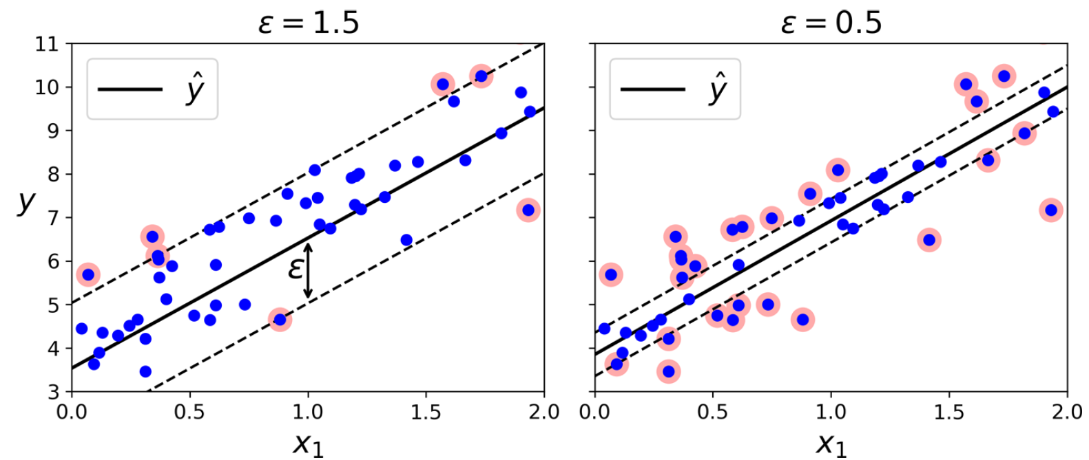
Linear SVM Regression
Regression models trained on some random linear data, one with a large margin (ϵ = 1.5) and the other with a small margin (ϵ = 0.5).

Slide 37
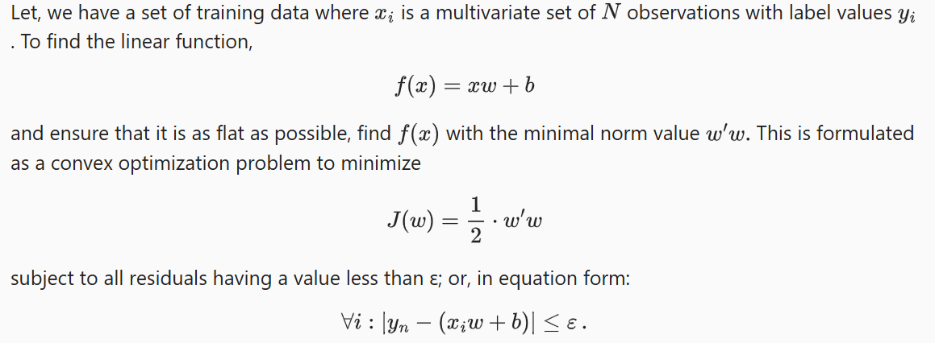
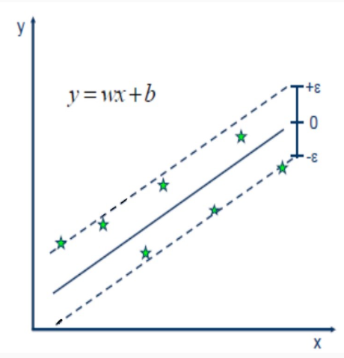
Linear SVM Regression

Slide 38
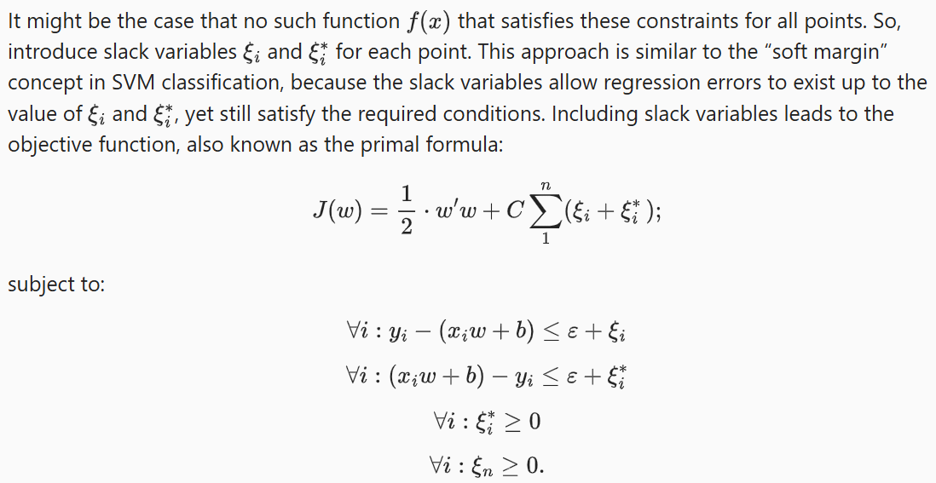
Linear SVM Regression

Slide 39
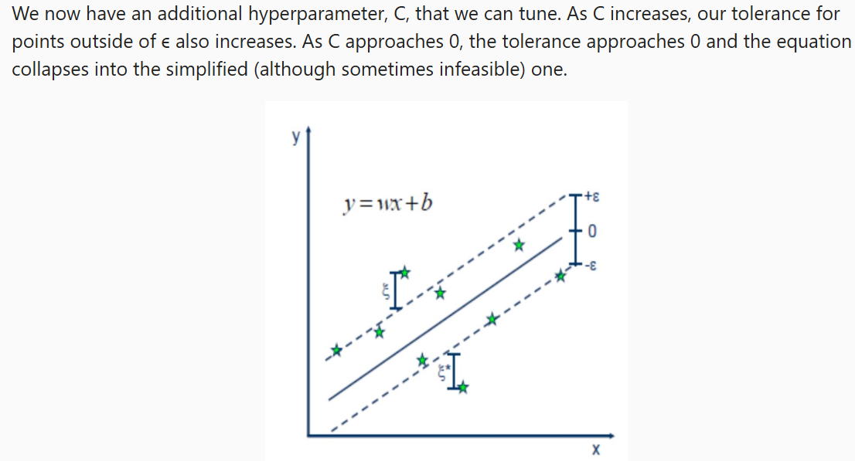
Linear SVM Regression

Slide 40
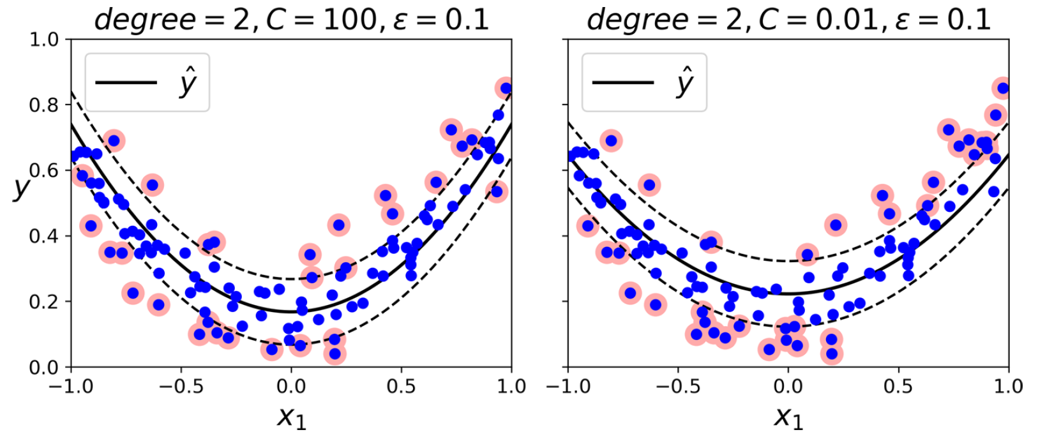
Non Linear SVM Regression
using a second-degree polynomial kernel

Slide 41
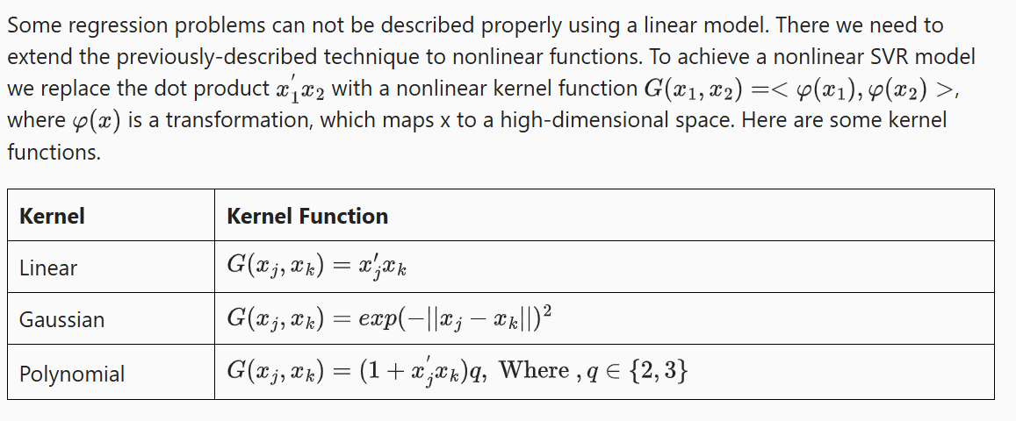
Non Linear SVM Regression

Slide 42
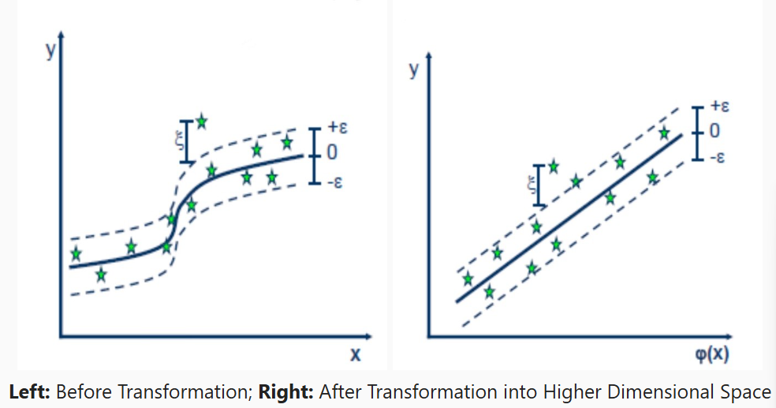
Non Linear SVM Regression

